Slide 1


ECEN 404 Final Presentation Team 36 Mesh Walkie Talkies Cole Cieslewicz, Jaiah Steele, Junsu Yeo TA: Niloofar Borzooei Sponsor: Giuseppe Rizzi

Slide 2
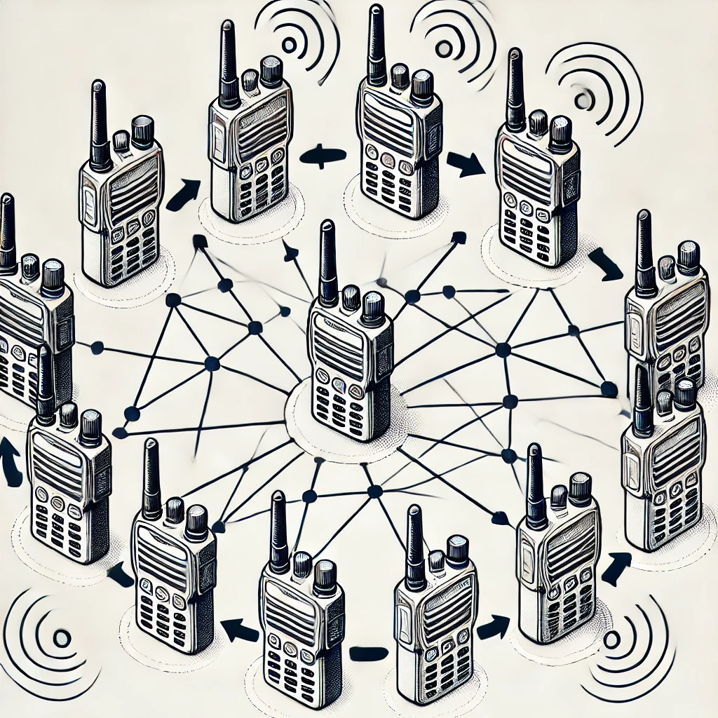
Problem Overview
Conventional Walkie-Talkies:
Require close, limited range of communication.
RF can be blocked by obstruction, weather, curvature of the earth etc.
No network advantage.
Our solution:
Mesh network to extend communication range and reliability.
Uses include: construction, search and rescue scenarios, altitude differences, high obstruction environments.
Notes:
Kyle

Slide 3
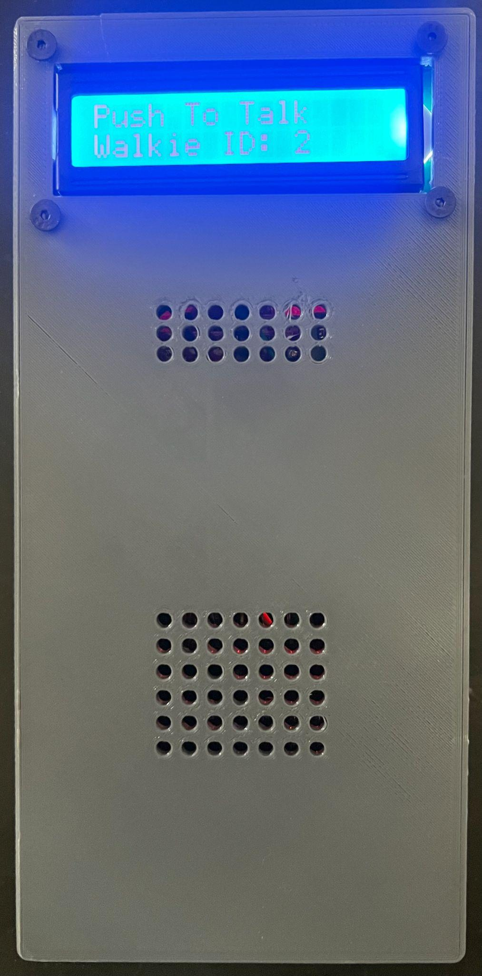
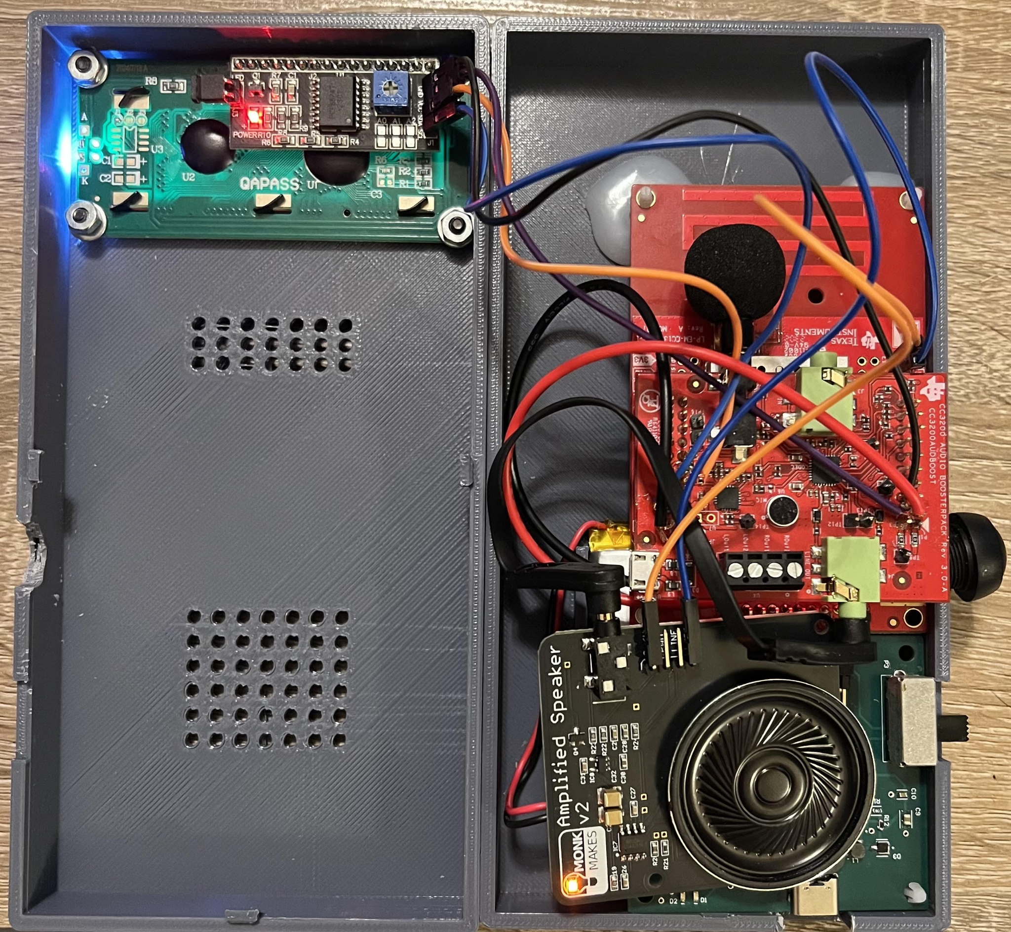
Integrated Project Diagram
Microphone for audio input
Button press to speak and transmit audio
Slide switch to turn on and off device
Speaker for audio output
LCD Display for real time updates
USBC port to charge LiPo battery

Slide 4
Engineering Design Accomplishments
Jaiah Steele
Slide 1: Push-To-Talk & LCD Interface Design
Designed push-to-talk system using GPIO interrupt on CC1354P10.
Wrote C LCD source (lcd.c) and header (lcd.h) for I2C 1602 display (converted to C from python).
LCD dynamically updates based on system state:
“Transmitting W#” when PTT is pressed.
“Receiving W#” on incoming packet.
“Push To Talk: W#” when idle.
LCD functions are integrated with transmit/receive logic.
Seamless coordination between GPIO events, RF packets, and LCD updates.

Slide 5
Engineering Design Accomplishments
Jaiah Steele
Slide 2: Audio Processing & RF Communication Integration
Compressed 16-bit I2S microphone input to 8-bit PCM at 8kHz sampling rate.
Switched from Wi-SUN to TI Proprietary Mesh for lower latency and better control.
Merged RFechoRX and RFechoTX into one unified PTT-driven walkie-talkie program.
Echo-based relay function using memcpy() to rebroadcast packets, with Walkie-Identifiers allow users to speak simultaneously (pseudo full-duplex).
Transmitting 255-byte packets every 41ms using 50kbps Sub-1 GHz PHY.
Current status: Tones audible through mesh, but speech remains unintelligible — working on filters, smoothing, and improved compression.

Slide 6
Engineering Design Accomplishments
Jaiah Steele
Test | Result
RF Range per Node | ~150m
Mesh Hop Count | Tested with 3 walkies
Sampling Rate | 8KHz tested and verified locally (local launchpad microphone to speaker pipeline no RF)
LCD real time feedback | Tx/Rx status real time
Voice Quality | Currently unintelligible working to improve
Obstruction testing | Walkies work through obstruction

Slide 7
Engineering Design Accomplishments
Cole Cieslewicz
Enabled bidirectional communication with send and receive functionalities, including persistent receive (within rfEchoTx.c and rfEchoRx.c).
Enabled backup text input and output via UART (within rfEchoTx.c and rfEchoRx.c).
Validated latency near zero and consistent function across large distances.
Enabled pathway for audio integration with general GPIO compatibility.

Slide 8
Engineering Design Accomplishments
Cole Cieslewicz
Simplified mode-switching (Tx-Rx) code to reduce in-between processing bottlenecks.
Implemented a variety of audio codecs to most efficiently compress and decompress audio.
Changed configuration settings to prioritize data over distance (including shift to 915 Mhz).
Used ADPCM (Adaptive Differential Pulse Code Modulation) to transmit packets of non-audio data pre-limited in its size (adpcm-lib.c and adpcm-test.c).
Integrating each of the various programs to enable audio processing in the main program.

Slide 9
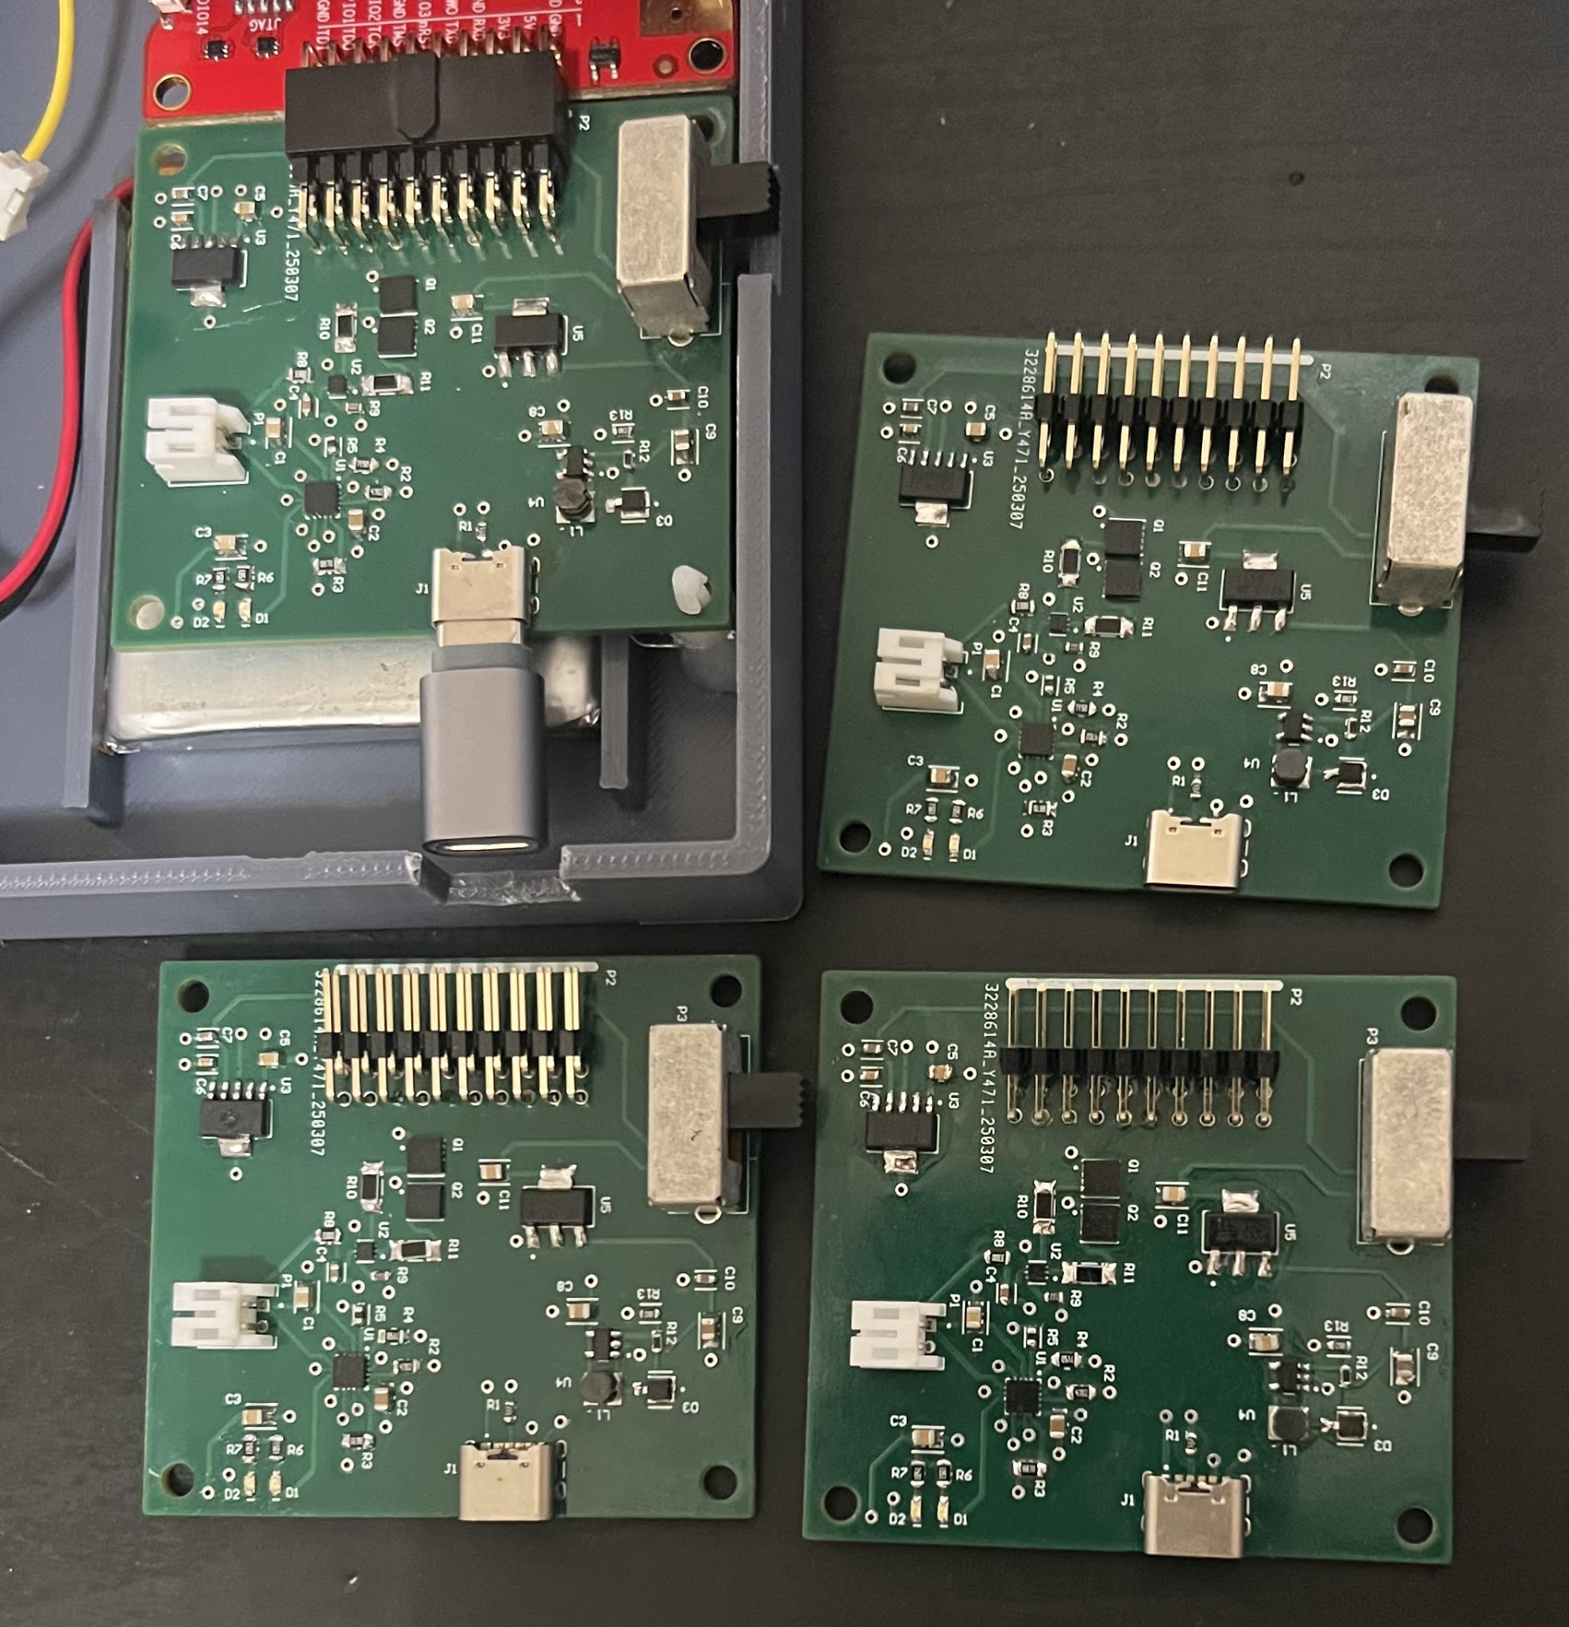
Engineering Design Accomplishments
Junsu Yeo
Designed, assembled, and tested 4 power supply PCBs.
Powered by 3.7V 2500mAh battery.
LDO to drop the 3.7V to 3.3V.
Boost converter and LDO to boost and step up the voltage to 5.0V.
Battery charger IC that provides charging current of 1250mA through the USBC port.
Battery protection IC protecting the battery from 2.8V to 4.2V.
DPDT power switch.

Slide 10
Testing
Junsu Yeo
Line Regulation Test Load Regulation Test Battery Life Test
Input Voltage [V] | 5V V_{OUT} [V] | 3.3V V_{OUT} [V]
3.0 | 4.9847 | 2.9986
3.1 | 4.9948 | 3.0980
3.2 | 4.9847 | 3.1986
3.3 | 4.9845 | 3.2982
3.4 | 4.9845 | 3.3048
3.5 | 4.9846 | 3.3048
3.6 | 4.9845 | 3.3048
3.7 | 4.9848 | 3.3048
3.8 | 4.9846 | 3.3048
3.9 | 4.9842 | 3.3049
4.0 | 4.9843 | 3.3053
4.1 | 4.9846 | 3.3053
4.2 | 4.9846 | 3.3054
V_{OUT} = 3.3V
Case | Current Draw
Device just powered | 41mA
Transmitting | 58mA
Receiving | 358mA
Load [mA] | Output Voltage [V]
0 → R_{L} = 0Ω | 3.3147
40 → R_{L} = 100Ω | 3.2942 (Pk-Pk: 175mV)
50 → R_{L} = 64Ω | 3.2405 (Pk-Pk: 175mV)
81 → R_{L} = 44Ω | 3.2534 (Pk-Pk: 150mV)
96 → R_{L} = 33Ω | 3.2501 (Pk-Pk: 175mV)
150 → R_{L} = 22Ω | 3.2181 (Pk-Pk: 200mV)
Battery life is 23.5 hours assuming:
20% Receive
20% Transmit
60% Idle
Battery was able to power the system left alone for 40 hours.
Battery takes 5-6 hours to fully charge.
V_{OUT} = 5.0V
Load [mA] | Output Voltage [V]
0 → R_{L} = 0Ω | 4.9848
54 → R_{L} = 200Ω | 4.9788 (Pk-Pk: 250mV)
108 → R_{L} = 100Ω | 4.8960 (Pk-Pk: 180mV)
145 → R_{L} = 75Ω | 4.9476 (Pk-Pk: 150mV)
170 → R_{L} = 70Ω | 4.9314 (Pk-Pk: 100mV)
200 → R_{L}= 60Ω | 4.8835 (Pk-Pk: 100mV)
250 → R_{L} = 54Ω | 4.9375 (Pk-Pk: 50mV)
500 → R_{L} = 50Ω | 4.8306 (Pk-Pk: 200mV)

Slide 11
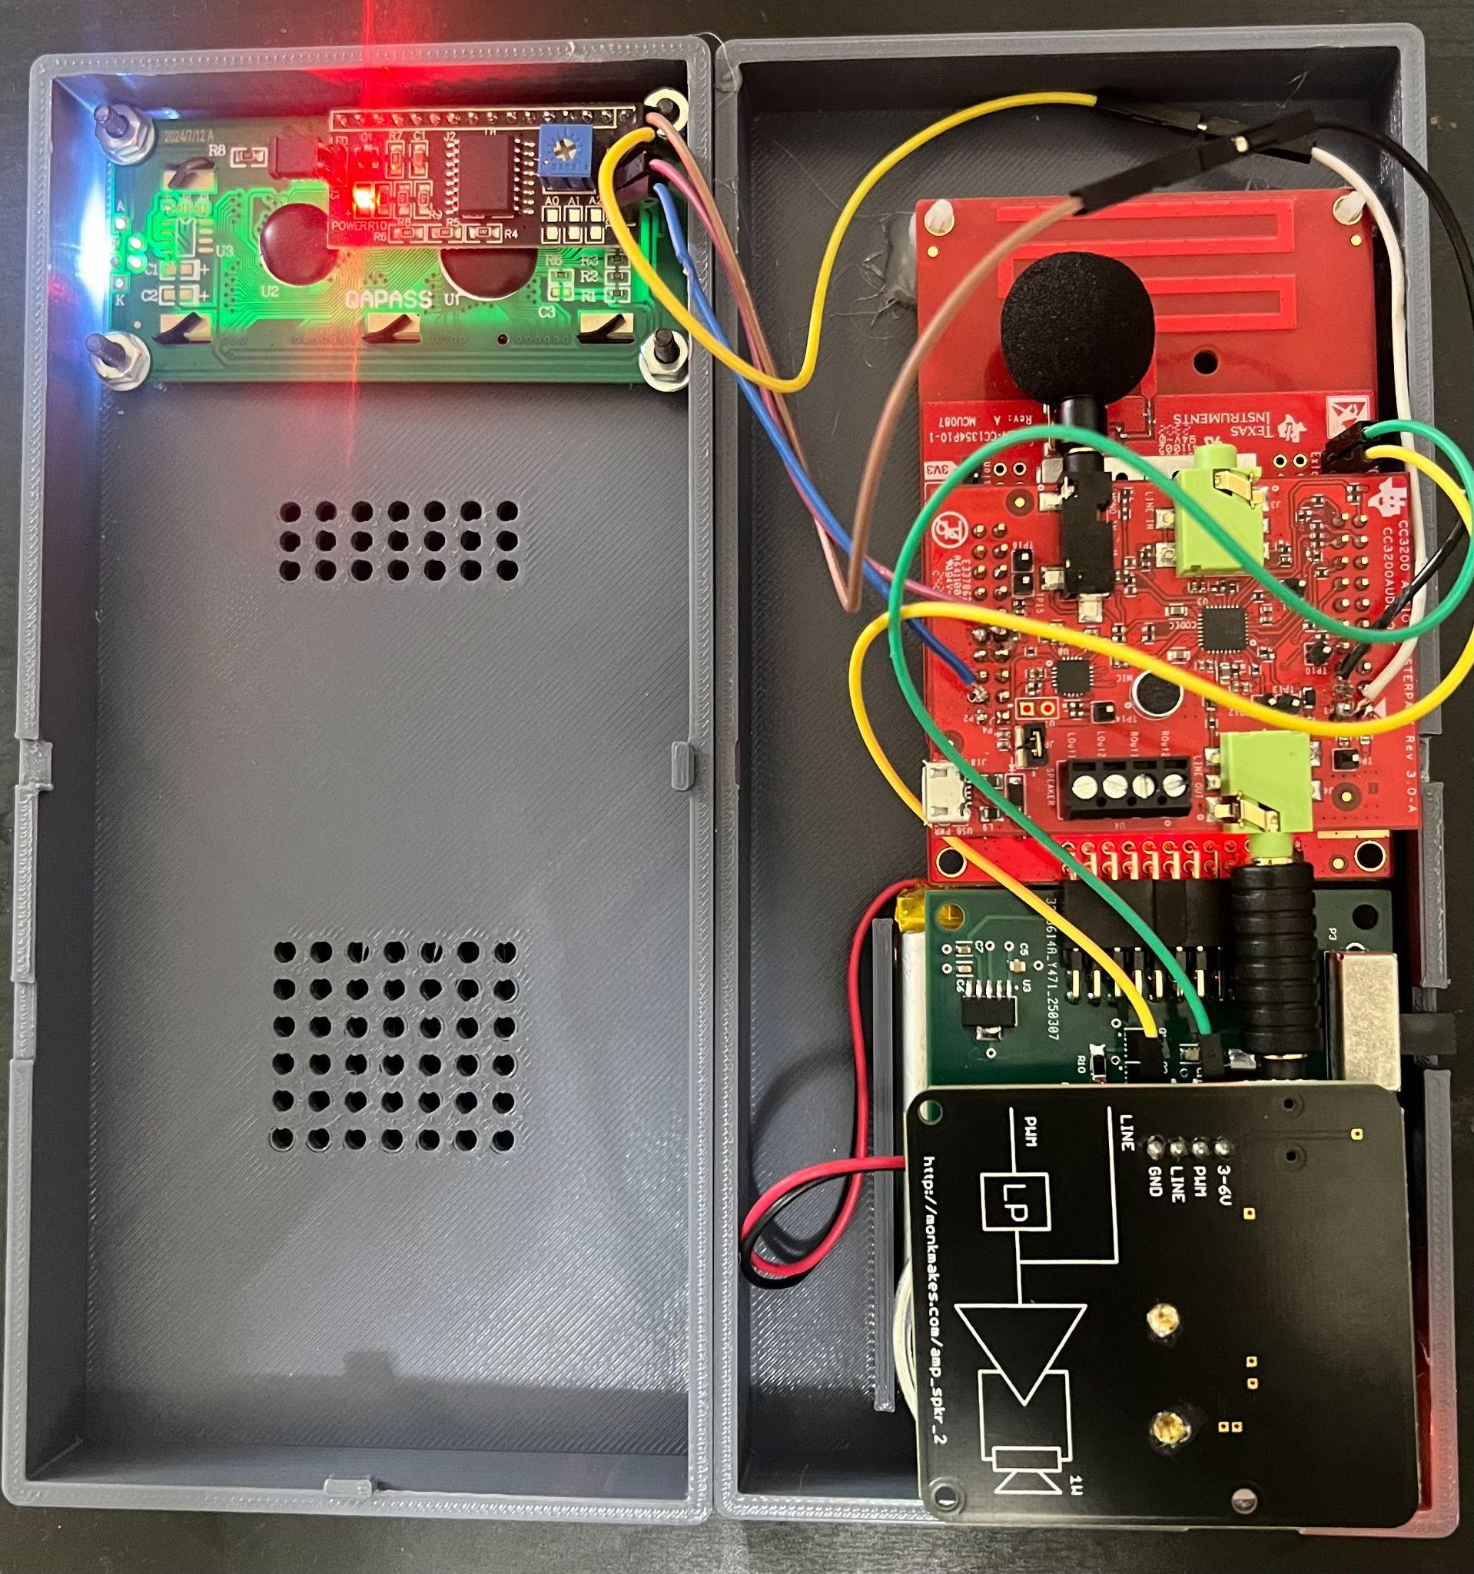
Engineering Design Accomplishments
Junsu Yeo
Designed a 3D printed case that properly encloses all components.
Created openings in the proper positions in the case for users to access the transmit button, power switch, and USBC charging port.
Mounted the display, launchpad, and power PCB.
Challenges: This is a proof of concept. Had to be a very large case compared to a standard walkie talkie due to the MCU and audio hardware teammate Q-dropping the course. Theoretically, all hardware could be assembled within a single PCB.

Slide 12
Integrated System Results
The device can be powered on by sliding the power switch to the on position.
Once device is on, the user can press the transmit button located on the side of the walkie talkie and talk into the microphone.
MCU compresses from 16-bit audio and transmits.
All other walkie-talkies within the range will receive, process, and decompress audio as well as copy/transmit the compressed audio packets to all other devices within their extended range.
The audio received by a device will be played out on the speaker.
The LCD will show when the device is transmitting or receiving, updating the user which device the audio is being transmitted from.

Slide 13
Integrated System Results
Spec | Min | Accomplished
# Devices | 3 | ✅
Unobstructed Range (of 1 device, not mesh) | 100m | ✅
Latency (including mesh relay) | Not noticeable (~200ms) | ✅
Size in each direction (excluding antenna) | Handheld (<7in) | 7.3 inches
Battery Life (while powered on) | 24 hours | ~23.5 Hours
Audio sampling rate | 8 kHz | ✅
Bits per sample | 8 bits | ✅16-bit -> 8bit
Audio | Understandable with normal speech | work in progress

Slide 14
Conclusions
Issues:
Audio hardware teammate Q-dropping,
Had to use CC3200 AUDBOOST as our off the shelf component making processing audio much more intricate.
Had to use I2S buffer transactions over using analog to digital converters
Current Status:
Integration complete, but the input audio from the microphone is not fully validated.

Slide 15
Questions?

Slide 16
Thank you!

